Slide 1

Fake News Detection
Using Deep Learning
Our end goal is to develop an intelligent system that accurately detects and prevents fake news using advanced machine learning and deep learning techniques.
by Sharnjot kaur

Slide 2
Table of Contents
1. Introduction
2. Objectives
3. System Requirements
4. Tools Used
5. Technologies Used
6. Data Gathering
7. Data Preprocessing
8. Model Building (using TF-IDF / PassiveAggressiveClassifier)
9. Model Accuracy Check
10. User Interface for Model Interaction
11. Conclusion & Future Improvements

Slide 3
Introduction
Fake news spreads quickly and can shape people's opinions in misleading ways.
It often comes from sources like social media, blogs, and unreliable news sites.
Using data analysis and AI, we can identify patterns to detect and stop fake news more effectively.

Slide 4
Objectives
✔ Develop an AI system to detect fake news accurately.
✔ Use machine learning techniques to identify and classify misinformation.
✔ Analyze data patterns to improve the detection process and prevent the spread of fake news.

Slide 5
Hardware and Software Requirements
Sr. No. | Requirements | Type | Requirement Description
1. | Hardware Requirements | Processer | i5 or above with a Supported GPU
 |  | RAM | 8 GB RAM or higher
 |  | Hard Disk space | 256 GB SSD
2. | Software Requirements | Operating System | Windows 10/ Windows server 2012
 |  | Prerequisite | Python (3+), Keras, Annaconda and supporting Libraries
 |  | Other | Administrator & internet access is required in the windows machine, it should be open environment.
 |  | Application access | VPN access (If required), Portal access, Application access, shared point access, SMTP port & credentials.
 |  | Browser | Google chrome, for JupyterNotebook

Slide 6


Tools Used
For creating AI models
For making Front-end UI

Slide 7







Technologies Used
Libraries
Python As a programming language

Slide 8

NumPy, short for Numerical Python, is a fundamental library in Python for numerical computing. It provides support for large, multi-dimensional arrays and matrices, along with a collection of mathematical functions to operate on these arrays efficiently. Here's why NumPy is essential in various fields, including data science, machine learning, and scientific computing.

Slide 9

Pandas is a library for data manipulation and analysis in Python.
Here's why Pandas is indispensable in these tasks:
Data Structures
Data Cleaning
Data Exploration
Data Analysis
Data manipulation

Slide 10

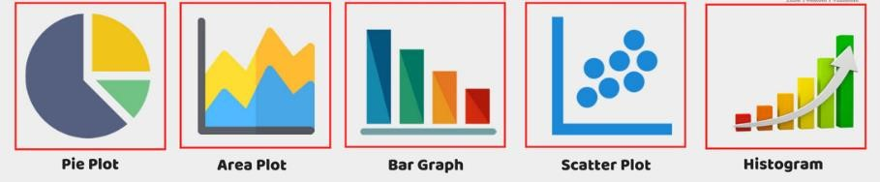
MatplotLib :- Matplotlib is a comprehensive library in Python widely used for creating static, interactive, and publication-quality visualizations. Here are some key aspects of Matplotlib:
Versatility
Publication-Quality Graphics
Integration with Jupyter Notebooks
Matplotlib Pyplot Interface

Slide 11

Scikit-learn, often call as sklearn, is a powerful and user-friendly library for machine learning in Python. Here's an overview of its key features and functionalities:
Comprehensive Algorithms:
User-Friendly Interface
Extensive Documentation
Integration with NumPy and Pandas
Model Evaluation and Validation
Feature Extraction and Selection

Slide 12
Data Gathering
In this project, we used the Python library BeautifulSoup to gather data from the web. The data was collected from the website Politifact ( https://www.politifact.com/factchecks/list/?page= 1).
Which provides fact-checked news articles. We collected more then 21,000 news articles to train and test our fake news detection model.

Slide 13
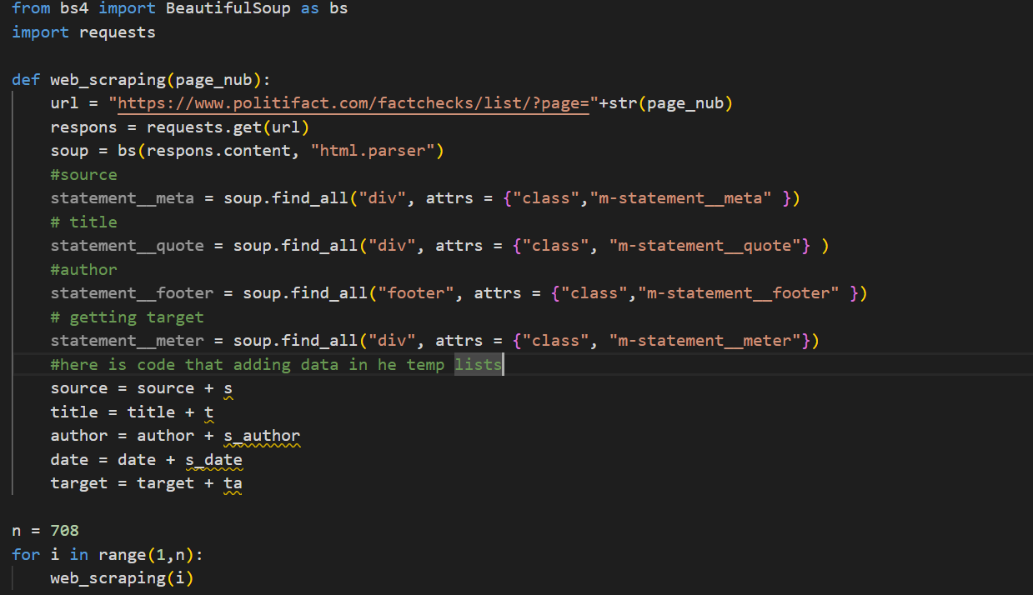
code for data gathering

Slide 14
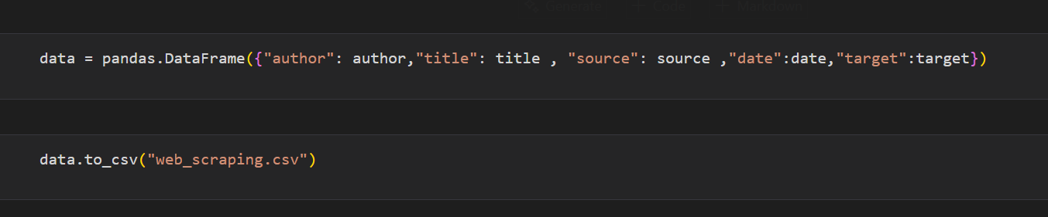
Data Prepossessing
For data preprocessing, we used the Pandas library to clean and organize the collected data. We converted the raw data into a structured format by creating a Pandas DataFrame. After processing the data, we saved it into a CSV file using Pandas functions for further analysis and model training.

Slide 15
Data Prepossessing
We are using powerful technologies like Natural Language Processing (NLP) to work with and understand text data. For this, we used the NLTK library, which helps in processing and analyzing language-based data.
As part of our approach, we used two text files:
positive-words.txt – contains a list of positive words
negative-words.txt – contains a list of negative words
We tokenized the text and applied stemming to reduce words to their root form, making the data easier to analyze for fake news detection.

Slide 16
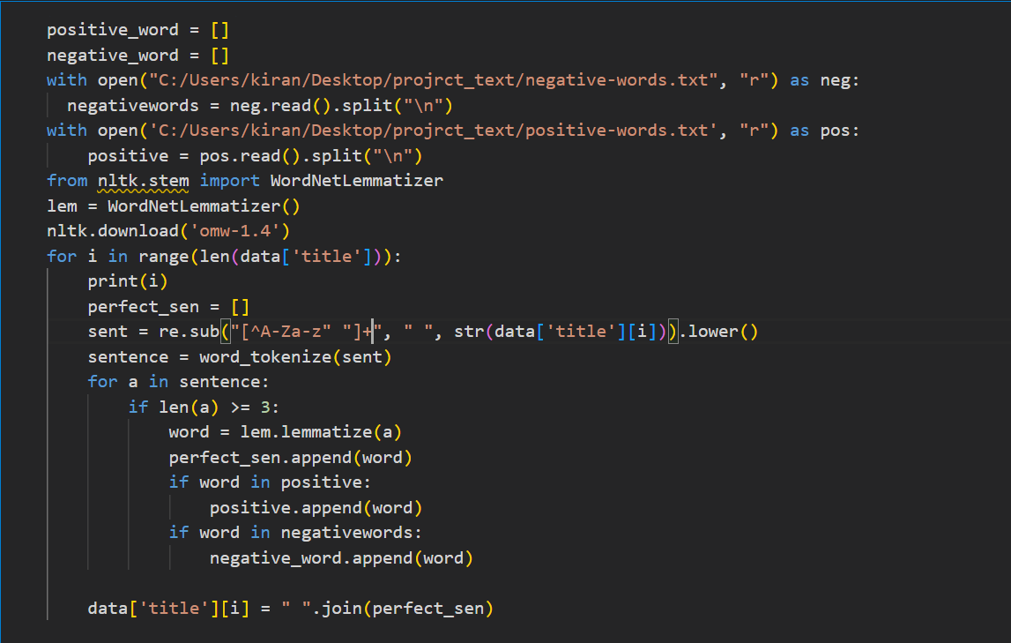
code

Slide 17
Data Preprocessing
🔸 Removing irrelevant characters and stop words.
🔸 Converting text to lowercase, stemming, and lemmatization.
🔸 Removing duplicate entries for accuracy.
from nltk.corpus import stopwords

Slide 18
Dividing our data
Dividing our data into two parts is important to check how well our model performs. After training the model, we need to test it on unseen data to know its accuracy.
To do this, we split the data into training and testing sets using the train_test_split function from the scikit-learn (sklearn) library. This helps us evaluate how accurately the model can detect fake news on new data.

Slide 19
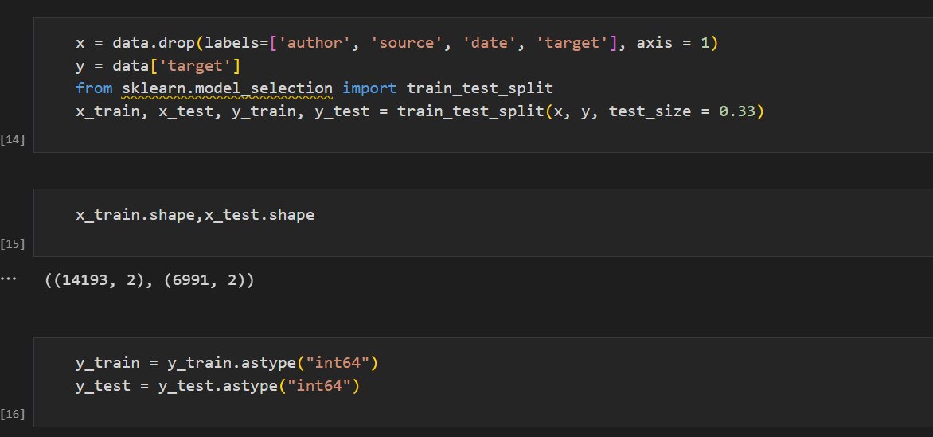
Dividing our data Code

Slide 20
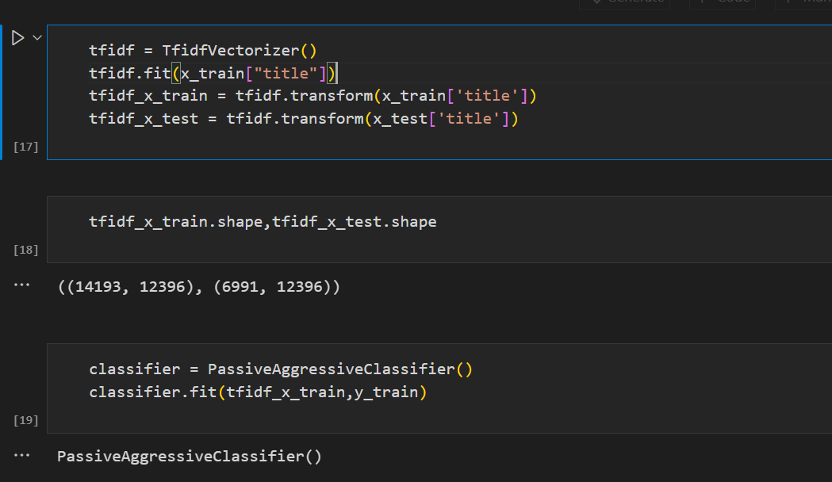
Model Training

Slide 21
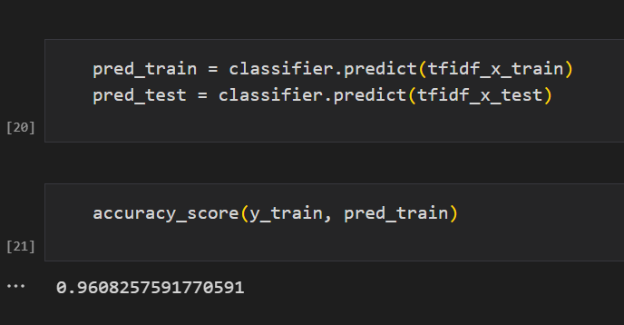
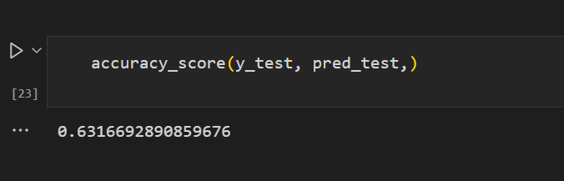
Check Model Accuracy
On Training Data
96%
On Testing Data
63.16%

Slide 22
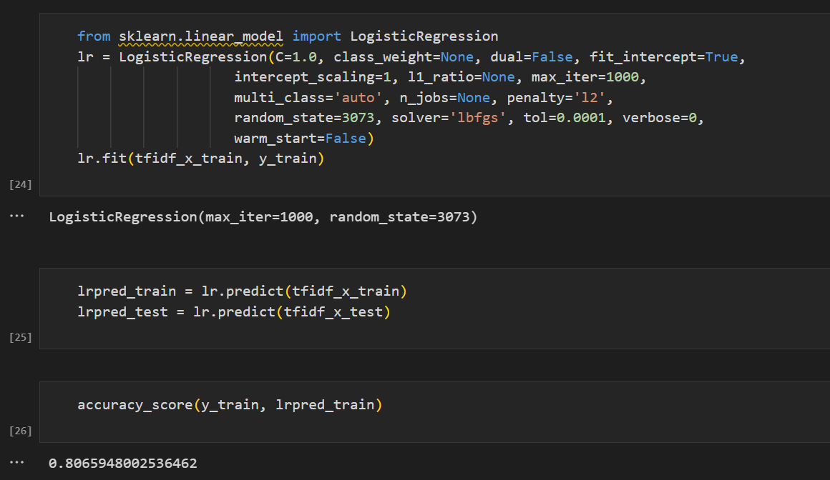
Second Model

Slide 23
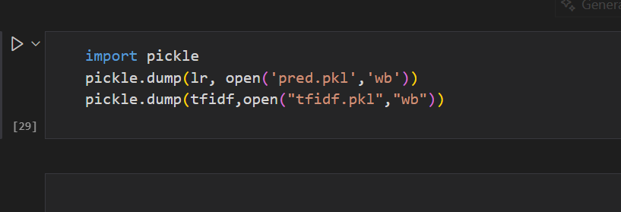
saving models

Slide 24
Let’s create a beautiful frontend where users can input news text and get instant results from our trained model.

Slide 25
Make UI
There are multiple options available to build a user interface for this project, such as Flask, Django, Tkinter, Streamlit, and more.
For this project, we chose Streamlit because it allows us to quickly create an interactive and user-friendly web app with minimal code.

Slide 26

Streamlit is a super easy and fast way to build web apps for machine learning and data science projects. You write just a few lines of Python code, and Streamlit turns it into a nice-looking, interactive web app. It’s perfect for quickly sharing your AI model with others—no need to know web development!

Slide 27
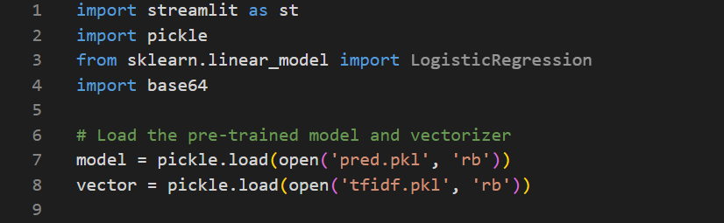
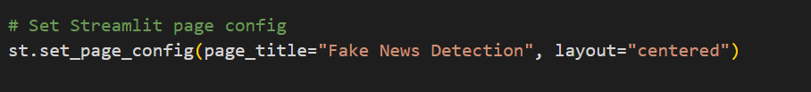
Load Models

Slide 28
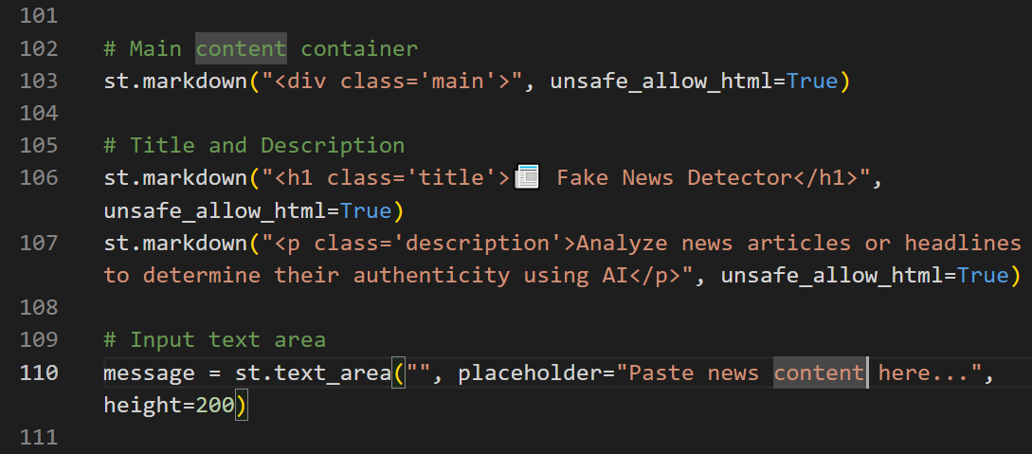
Make UI Add Title, Text Box and Button

Slide 29

UI View

Slide 30
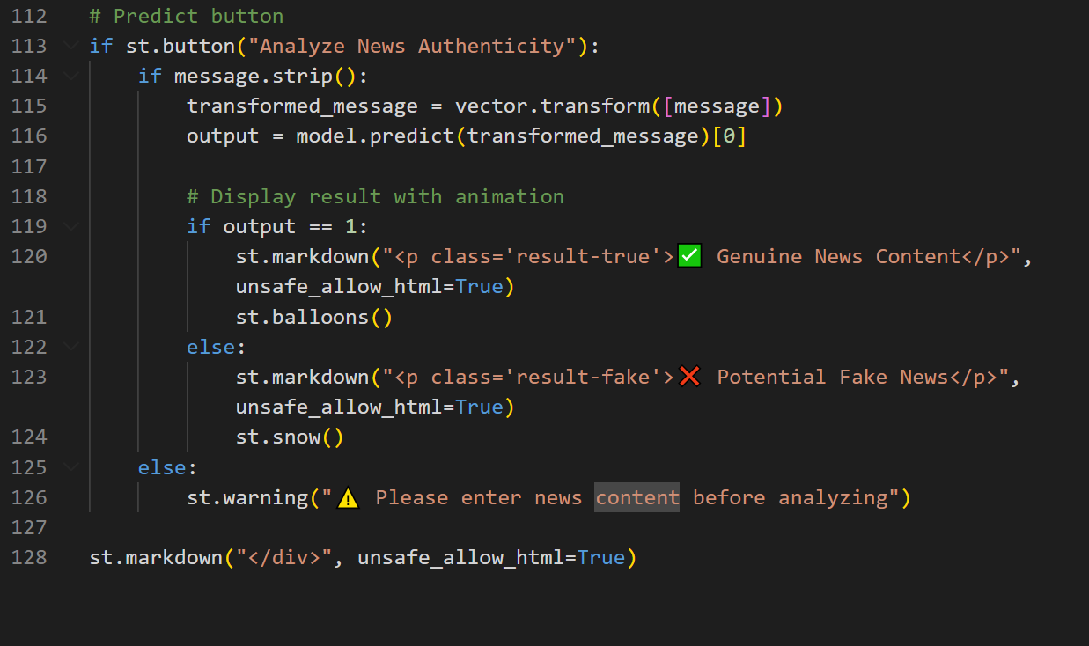
Prediction

Slide 31

Test our project

Slide 32

Test our project

Slide 33
Conclusion & Future Scope
Conclusion: Fake news detection is crucial to prevent misinformation and ensure accurate information reaches the public.
Improved Accuracy: Enhancing detection methods using advanced data analytics techniques.
Real-Time Monitoring: Developing faster systems to detect fake news as it spreads.
Better Fact-Checking: Integrating with trusted fact-checking organizations for verification.
User Awareness: Educating people to critically analyze news before sharing.
Ethical AI Use: Ensuring fair and unbiased detection methods.

Slide 34


